Slide 1
Overview of Operating System
Introduction and Overview
Operating System Structures

Slide 2
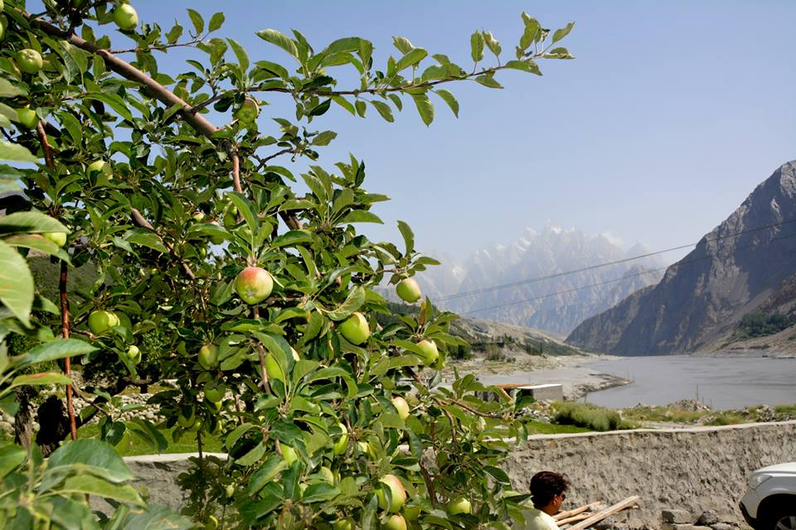
Computer System Organization
Hardware interrupt
A signal sent to the CPU anytime
Software interrupt
Execute a special operation
System call or monitor call
Interrupts cause a transfer to take place to the relevant interrupt service routine (ISR)
Methods of transfer varies
Saving the address of the interrupted instruction and the state of the processor
Registers, runtime stack or fixed memory addresses
Notes:
What are interrupts? Exceptions?
Vectored interrupt? How?

Slide 3
Storage Structure
Units of storage
Bit and bytes
Kilobyte, Megabyte and Gigabyte
Terabyte and Petabyte
Main memory has program and data accessed by the CPU for execution directly
Volatile and too small to contain all information
Secondary storage solves the problems
Extension of main memory
Store large quantities of information permanently
Storage system is organized in a hierarchy
Varies in speed, capacity, cost and volatility
Notes:
What do the units mean?

Slide 4
Storage Structure
Higher to lower levels
Decrease in speed
Increase in size
Decrease in cost
More persistence (non-volatile)
SSDs (Solid Storage Disks) are faster than magnetic disks and are nonvolatile
Flash memory is used in PDAs and other such devices
Design of memory system must balance all factors

Slide 5
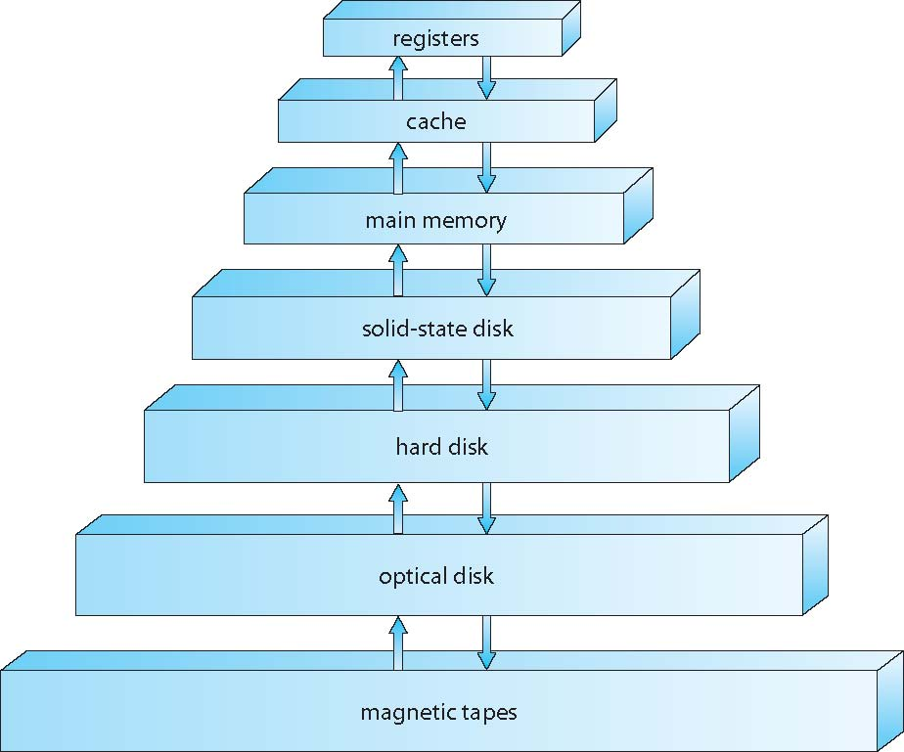
Storage-Device Hierarchy

Slide 6
Operating System Structure
Memory management is required when several jobs are resident in memory at the same time
CPU scheduling is the process of choosing one of several jobs in memory to run on CPU
Swapping may be required to swap processes in and out of main memory to ensure reasonable response time
Virtual memory is a technique that allows the execution of a process that is not completely in memory
Programs larger than the physical memory can be run
File system and disk management is also required to run time-sharing systems
Other requirements are protection, mechanisms for job synchronization and communication
Notes:
Many processes in memory figure

Slide 7
Operating System Operations
Operating systems are interrupt driven
Events are signaled by the occurrence of an interrupt or a trap
A trap or an exception
A software-generated interrupt caused by a special request from a user program or caused by an error
A number of user programs are sharing all the resources of the system
Protection is an essential requirement to be performed by the operating system

Slide 8
Dual Mode and Multimode Operation
How to achieve the objective of protection?
Distinguish between the execution of OS code and user-defined code
User mode and kernel mode of operation
Supervisor, system or privileged mode
Mode bit in hardware
Dual mode helps achieve the following
Protection of one user from another
Protection of system from users
Privileged instructions are needed
System calls allow users to gain access to OS services
Treated by the hardware as a software interrupt

Slide 9
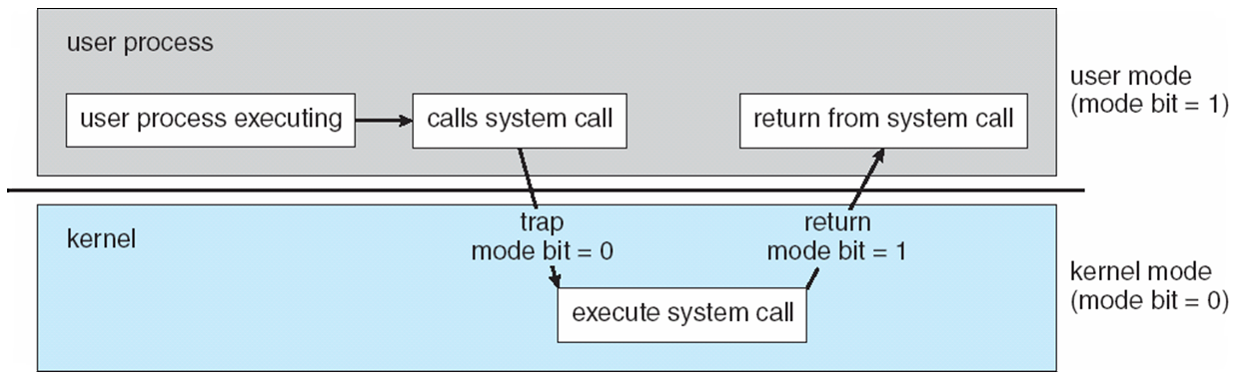
Transition from User to Kernel Mode

Slide 10
Dual Mode and Multimode Operation
The concept can be extended beyond two modes of operation
A mode when VMM (Virtual Machine Manager) is in control of the system
Virtualization management software
More privileges than the user but less privileges than the kernel
Some CPUs support four privilege levels
Initial control is in the OS
User program runs in user mode
Any OS function can be requested by the user through system call

Slide 11
Timer
How does the OS maintain control by not allowing processes getting stuck in an infinite loop?
Use a timer that is set to interrupt the CPU after a specific period of time
Period may be fixed or variable
Implementation of the variable timer
A fixed rate clock and a counter
Instructions that modify the counter are privileged

Slide 12
Process Management
A program in execution is a process
Program is passive and process is active entity
Process is a unit of work in a system
Process needs resources for execution
Resources are allocated before/during execution
OS process management activities
Scheduling processes and threads on the CPUs
Creation and deletion of user and system processes
Suspending and resuming processes
Providing mechanisms for process synchronization
Providing mechanisms for process communication

Slide 13
Memory Management
CPU accesses main memory directly
Programs and data must reside in main memory for execution
Several programs are in main memory at the same time for efficient utilization of CPU
Memory management schemes are used to allocate and reclaim it
OS memory management activities
Keeping track of which part of memory is used by which process
Deciding which processes (or parts) and data to move into and out of the memory
Allocating and de-allocating memory space as needed

Slide 14
Storage Management
OS provides a uniform, logical view of information storage to make the computer system convenient for use
It abstracts and defines a logical storage unit
A file
File-System Management
File is the collection of related information
Information storage is done on various types of media
Magnetic disk, optical disc, magnetic tape, etc.
OS file management activities
Creating and deleting files
Creating and deleting directories

Slide 15
Storage Management
Supporting primitives for manipulating files and directories
Mapping files onto secondary storage
Backing up files on stable storage media
Mass-Storage Management
Mass-storage is the backup of main memory
Everything is in secondary storage until it is loaded in main memory
OS mass-storage management activities
Free space management
Storage allocation
Disk scheduling

Slide 16
Mass Storage Management
Speed of this subsystem is important for efficiency
Tertiary storage devices provide low cost, low speed and large capacity backups
Not crucial for system performance
Caching
An important principle of computer systems
When an information is used, it is kept in a faster storage system on a temporary basis
The cache
Information is first checked in cache before accessing the next level of memory
Caching may be implemented in hardware or in software

Slide 17
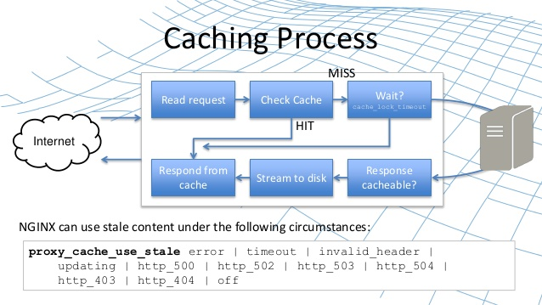

Slide 18
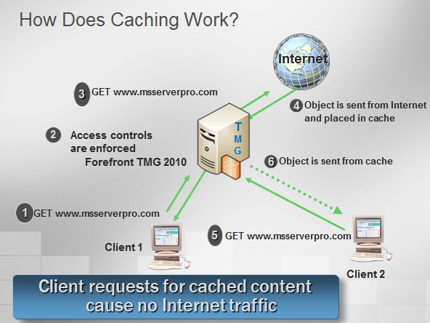

Slide 19
Caching
Hardware controlled cache are outside the scope of OS
Cache management techniques are required for software controlled cache
Selection of cache size and replacement policy
Performance between the levels of storage
Movement of information between levels is implicit or explicit
Transfer between disk and memory
Controlled by the OS
Transfer between hardware cache and CPU registers
Controlled by the hardware

Slide 20
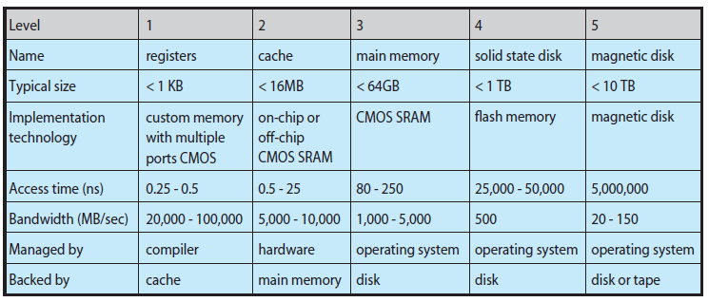
Performance of Various Levels of Storage

Slide 21
Caching
Same data may appear at different levels in a hierarchical storage structure
When and how is an update at one level propagated to other levels
Single process execution environment does not pose a problem
In a multiple process execution environment, this problem should be resolved
Cache coherency problem arises in a multiprocessor environment with multiple caches

Slide 22
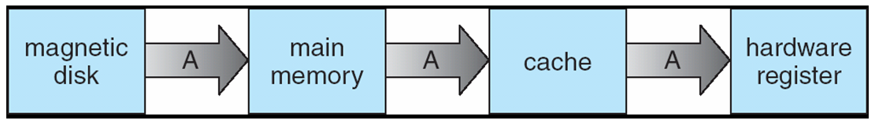
Migration of Integer A from Disk to Register If A is modified in Register, when and how is it propagated to the other levels of memory hierarchy?
The issue of coherence

Slide 23
Input-Output Systems
OS should hide the details of hardware characteristics from user and application programs
OS components that handle I/O subsystem
A memory management component that includes
Buffering, caching and spooling
A general device-driver interface
Drivers for specific hardware devices
How interrupt handlers and device drivers form the I/O subsystem?
How the I/O subsystem interfaces to other system components?

Slide 24
Protection and Security
Protection is a mechanism for controlling the accesses of processes or users to the defined resources
OS provides means to enforce them
Protection can improve reliability
Security is a mechanism to defend a system from internal and external attacks
Includes attacks from viruses
Some systems place some of the larger functionalities in additional software
List of user names and IDs maintained by the OS
Authorization and authentication system uses them to identify and authenticate users
Privilege escalation may be done by the OS

Slide 25
Computing Environments
How operating systems are used in a variety of computing environments?
Traditional Computing
Does not exist in the form that was a decade ago
Networked computers, portals, wireless connections, etc.
Mobile Computing
Refers to computing on handheld smart phones and tablet computers
There is a large growth in the range of applications in mobile devices
Memory capacity and power consumption are limited
Apple iOS and Google Android

Slide 26
Computing Environments
Distributed Systems
A collection of physically separate, possibly heterogeneous computer systems networked to provide access to resources
Increases computation speed, reliability, functionality and data availability
Some systems hide the details of the network and remote resources
Others explicitly expose the local and remote resources
Networks vary in protocols, distance between nodes and transport media
Network operating system and distributed operating system

Slide 27
Computing Environments
Client-Server Computing
Most of today’s systems act as server systems to satisfy requests generated by client systems
User workstations are powerful
Servers are both compute servers and file servers
Compute servers provide an interface for the client to request an action to be performed by the server
File servers provide with a file-system interface

Slide 28
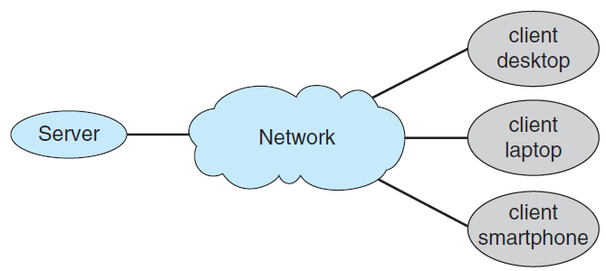
General Structure of a Client-Server System

Slide 29
Computing Environments
Peer-to-Peer Computing
Server bottleneck of client-server is resolved
All nodes are peers
Each node can act both as a client and as a server
How to determine the available services?
A node joining the network registers its service in a lookup service
Nodes which need a service contacts the lookup service
Discovery service is used to determine who can provide service
Broadcast a request

Slide 30
Computing Environments
Virtualization
A technology that allows an OS to run as application within other operating system
Emulation is used when source CPU type is different from target CPU type
Emulated code runs much slower than the native code
Interpretation is a form of emulation
High level language code is translated to native CPU instructions which is a virtual machine
Java Virtual Machine (JVM)
Virtualization
Operating system that is natively compiled for a particular CPU architecture
Runs within another OS also native to the CPU

Slide 31
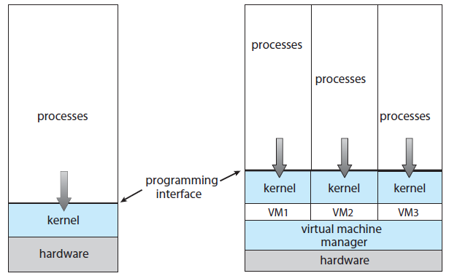
VMware

Slide 32
Computing Environments
Cloud Computing
A type of computing that delivers computing, storage and even applications as a service across a network
A logical extension to virtualization
Types of cloud computing
Public cloud
Available to anyone willing to pay for the services
Private cloud
Run by a company for its own use
Hybrid cloud
Include both public and private cloud components

Slide 33
Computing Environments
SaaS – Software as a service
One or more applications available via the Internet
PaaS – Platform as a service
A software stack ready for applications for use via the Internet
IaaS – Infrastructure as a service
Storage servers available on the Internet
Combination of several types may also exist
Cloud management tools are used to manage the resources and provide interfaces to cloud components

Slide 34
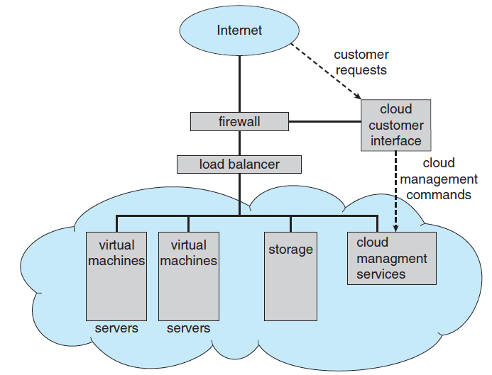
Public Cloud Computing providing IaaS

Slide 35
Computing Environments
Real-time Embedded Systems
Most prevalent form of computers
Computers found everywhere
Systems they run on are usually primitive
OS provides limited features
Limited to little or no user interface
Vary considerably in their capabilities
Embedded systems run real-time operating system (RTOS)
Rigid time requirements are imposed on execution of certain functions
System fails if the time constraints are not met

Slide 36
Operating System Structures
OS Services
OS Structures

Slide 37
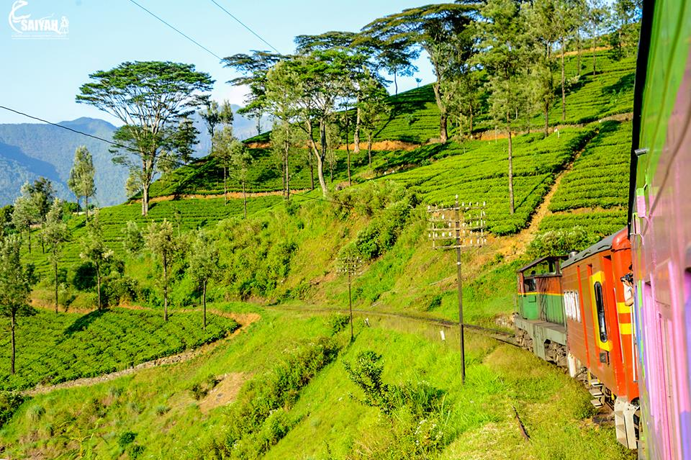
Operating System Structures
OS services
Interface of user and OS
OS functions provided through system calls
Types of System calls
Structure of OS
Defining goals of OS
Modularity and Layered approach
Mechanisms and policies

Slide 38
Operating System Structures
View an OS from several vintage points
Services offered by the OS
Interfaces made available to users and programmers
Its components and their interconnections
Viewpoints of users, programmers and OS designers

Slide 39
Operating-System Services
Identify common class of services among all OS
Set of services provided for the convenience of user
User Interface (UI)
Options are Command-line Interface (CLI)
Batch Interface
Graphical User Interface (GUI)
Program Execution
The system must be able to load a program and execute it, terminating normally or abnormally
I/O operations

Slide 40
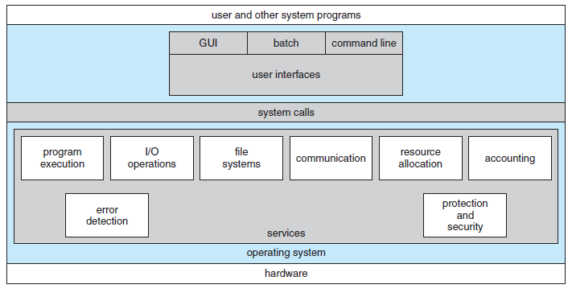
A View of Operating System Services

Slide 41
Operating-System Services
File-system manipulation
File management and access control management features should be provided
Communications
Processes need to communicate with one another
This can be implemented through message passing or shared memory
Error detection
Detect and take appropriate action to ensure correct and consistent computing
Set of services for efficient working of system
Resource allocation
Efficient allocation of resources without error and deadlocks

Slide 42
Operating-System Services
Accounting
For record-keeping, usage statistics and future planning
Protection and Security
Processes should not interfere with each other or with the OS processes
Protection ensures that all accesses to system resources are controlled
Security ensures that only authorized and authenticated users access the system and its resources
Defend all I/O devices from external threats and invalid attempts

Slide 43
User Operating-System Interface
There are two approaches for users to interface with the OS
Command Line Interface (CLI) or
Command Interpreter
Graphical User Interface (GUI)
Command Interpreter
Allows users to directly enter commands to be performed by the OS
A number of interpreters may be available to choose from
Shells: Bourne shell, Cshell of Unix
How are commands implemented?
There are two ways to implement it

Slide 44
User Operating-System Interface
Command interpreter itself contains the code to execute the command
Size is determined from the number of commands
Commands are implemented through system programs
Interpreter only identifies which program to load into memory
CI program is small and it does not need to change when new commands are added in the system
Graphical User Interface
Both CLI or GUI are personal preferences

Slide 45
System Calls
System calls provide an interface to the services made available by the OS
How are system calls used?
APIs hide the details of all the operation sequence
Invokes the functions on behalf of the application programmer
Provides portability between different systems
Windows API, POSIX-API, Java API
System call interface (SCI)
Run-time support system for most programming languages
Serves as the link to the system calls made available by the OS
Notes:
All POSIX based systems – all versions of UNIX, Linux and MAC OS X

Slide 46
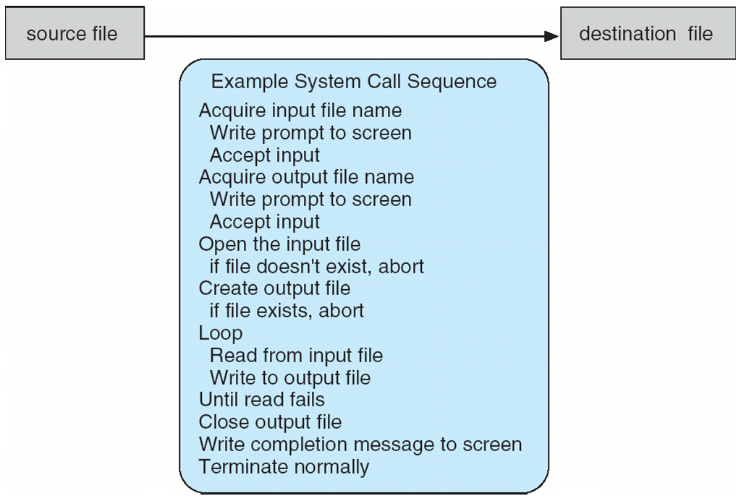
Example of a System Call
Copy from one file to another
Notes:
46

Slide 47
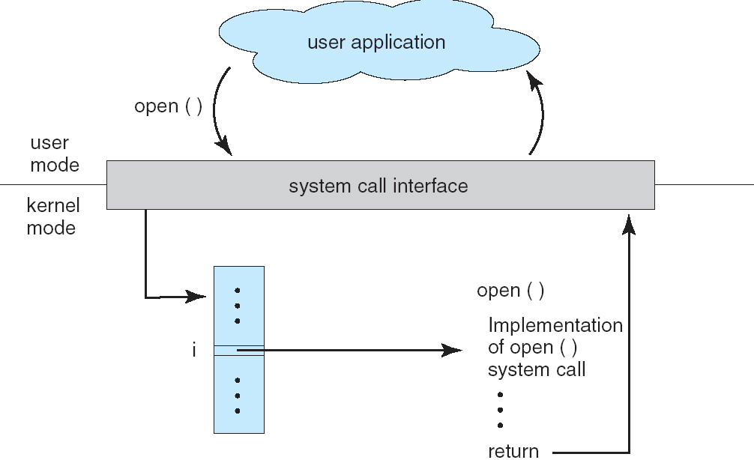
API – System Call – OS Relationship
The handling of a user application invoking the open() system call
Notes:
47

Slide 48
System Calls
Many system calls need parameters to be passed to the OS
Pass parameters in registers
Registers are fewer in number
Place the parameters in a block or table in memory
Place the address of the block in register
Push the parameters onto the stack by the calling program
Popped off by the OS routine

